Slide 1




Next Gen Employability Program
Full Stack Web Development with AI Tools
Team Details – NG_CP_Team_704
NAME- ANJALI DHEEK
NAME- ANMOL SINGH
NAME-ARYAN KUMAR
NAME-ANSHIKA JAIN
NAME-ANMOL JAGVIR
College: Inderprastha Engineering College, Ghaziabad

Slide 2

The content is curated from online/offline resources and used for educational purpose only.
Notes:
Speaker would be briefing the students that this content has been prepared for the educational purpose only and is referred from multiple sites which are cited in the last.​​
---------------------------------------------------​​
A disclaimer is a statement or notice that is intended to clarify, limit, or provide information about the scope, limitations, or potential risks associated with certain actions, information, products, services, or content. ​​
​​
​

Slide 3

Project Title
Sit Smart - Automated Examination Seating Arrangement System
Notes:
In this slide speaker will be introducing the program and its outcomes. The speaker will introduce himself in brief

Slide 4

Table of Contents
Introduction
Problem Statement
Proposed Solution
Key Features
Technology stack
System flowchart
Core Modules
Security measures
Conclusion and Future work
References
Notes:
This slide, The speaker will talk about the content that we will be covering in this session as follows:
Introduction
Importance of UI/UX in industry
History and Definitions of UI and UX
Key Differences between UI/UX
Use Cases
Significance in Web Development
Use Cases
Visual Design Principles
Design process
Color theory and psychology
Typography and readability
Layout and Spacing
Responsive design basics
Usability and Accessibility
Usability Aspects
Web Content Accessibility Guidelines (WCAG)
Inclusive design practices
Consistency
User Experience
User-Centered Design
User research methods
Interactive Elements and Feedback
Mini Case Study
Discussing a popular UI/UX design
Hands-On
Introduction to Figma for UI/UX design

Slide 5
Introduction
SIT SMART is an automated examination seating arrangement system designed to efficiently manage and organize the allocation of students during examinations. Traditional manual seating methods are time-consuming, difficult to manage, and prone to errors especially in institutions with a large number of students and examination halls.
It overcomes these challenges by using a rule-based digital approach to allocate seats based on exam details, room capacity, and student data. The system provides separate dashboards for administrators, students, and invigilators, ensuring transparency, accuracy, and smooth coordination. By reducing manual workload and ensuring fair seat distribution,
It enhances the overall efficiency and reliability of the examination process.
Notes:
This slide, The speaker will talk about the content that we will be covering in this session as follows:
Introduction
Importance of UI/UX in industry
History and Definitions of UI and UX
Key Differences between UI/UX
Use Cases
Significance in Web Development
Use Cases
Visual Design Principles
Design process
Color theory and psychology
Typography and readability
Layout and Spacing
Responsive design basics
Usability and Accessibility
Usability Aspects
Web Content Accessibility Guidelines (WCAG)
Inclusive design practices
Consistency
User Experience
User-Centered Design
User research methods
Interactive Elements and Feedback
Mini Case Study
Discussing a popular UI/UX design
Hands-On
Introduction to Figma for UI/UX design

Slide 6
Problem statement
In many colleges and universities, the examination seating arrangement is managed manually by faculty members. This process is time-consuming, error-prone, and inefficient. Common issues include overcrowding in some classrooms while others remain underutilized, accidental allocation of multiple students to the same seat, and the inability to effectively separate students of the same branch or subject to minimize malpractice. Additionally, students face confusion in finding their assigned exam rooms, and last-minute changes become difficult to manage.
Therefore, there is a need for an automated, web-based seating arrangement system that ensures fair, accurate, and efficient allocation of students to examination rooms while reducing the administrative workload.

Slide 7
Proposed Solution
Develop a web-based automated examination seating arrangement system.
Store and manage student, room, and exam data digitally.
Automatically allocate seats based on room capacity, exam details, and predefined rules.
Ensure fair distribution of students to minimize malpractice.
Provide role-based access for Admin, Students, and Invigilators.
Allow students to view their assigned seat and exam room easily.
Enable quick handling of last-minute changes in seating arrangements.
Reduce manual effort, human errors, and administrative workload.

Slide 8
Key Features
Automated seat allocation
Student seat search
Seating slip
Role-based access (Admin, Student, Invigilator)
Efficient room utilization
Anti-malpractice seating arrangement

Slide 9
Technology Stack
Backend: Django (Python) – handles business logic, authentication, and seat allocation
Frontend: HTML, CSS – used for creating responsive and user-friendly interfaces
Database: SQLite – stores student, room, exam, and seating data
Tools & IDE: Visual Studio Code – for development and debugging
Version Control: Git & GitHub – for code management and collaboration
Deployment: Local server / cloud hosting

Slide 10
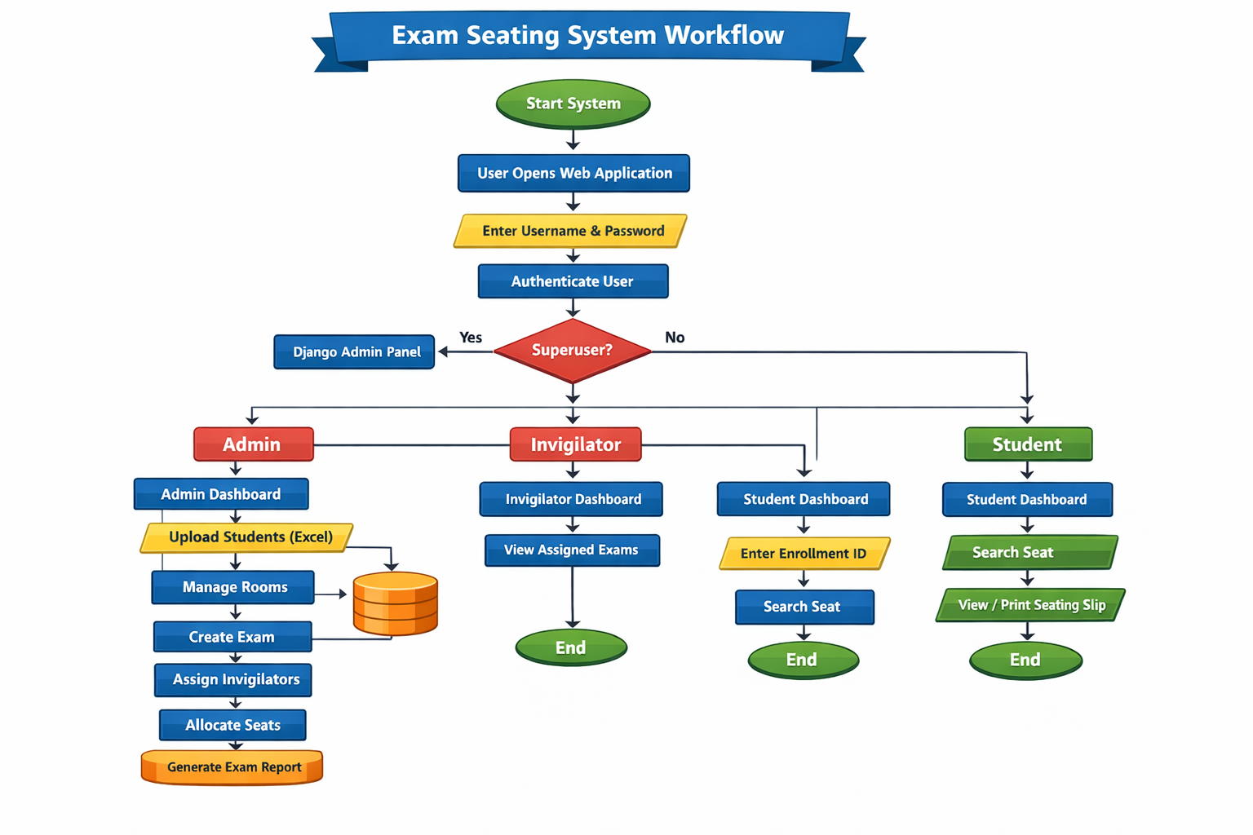
System Flowchart

Slide 11
Core modules
👤 1. User & Role Management
Login and authentication
Role-based access (Admin, Invigilator, Student)
Secure dashboard redirection
🛠️ 2. Admin & Exam Management
Upload student data (Excel)
Manage rooms and capacities
Create and manage exams
Assign invigilators

Slide 12
🎓 3. Student Seating Management
Student registration for exams
Seat assignment based on exam and room
Ensures fair and organized seating
Prevents duplicate seat allocation
👨‍🏫 4. Student & Invigilator Services
Student searches seat using enrollment ID
View, print, and download seating slip
Invigilator views assigned exams and rooms

Slide 13
Security Measures
Protection against unauthorized changes and misuse
Role-based login for admin, invigilator, and staff
Secure authentication with password encryption
Controlled access to exam, room, and student data
Regular data backup and audit logs
Notes:
This slide, The speaker will talk about the content that we will be covering in this session as follows:
Introduction
Importance of UI/UX in industry
History and Definitions of UI and UX
Key Differences between UI/UX
Use Cases
Significance in Web Development
Use Cases
Visual Design Principles
Design process
Color theory and psychology
Typography and readability
Layout and Spacing
Responsive design basics
Usability and Accessibility
Usability Aspects
Web Content Accessibility Guidelines (WCAG)
Inclusive design practices
Consistency
User Experience
User-Centered Design
User research methods
Interactive Elements and Feedback
Mini Case Study
Discussing a popular UI/UX design
Hands-On
Introduction to Figma for UI/UX design

Slide 14
Conclusion
The Sit Smart system effectively automates examination management by streamlining student allocation, room assignments, and invigilator tasks. It reduces manual errors, saves time, ensures fair seating arrangements, and provides role-based access and insightful reports, making exam administration more efficient and reliable.
Future work
AI-Based Intelligent Seat Allocation
Mobile app support for invigilators
QR in slip template
Student & Invigilator Mobile Access
Real-Time Exam Monitoring & Security
Notes:
This slide, The speaker will talk about the content that we will be covering in this session as follows:
Introduction
Importance of UI/UX in industry
History and Definitions of UI and UX
Key Differences between UI/UX
Use Cases
Significance in Web Development
Use Cases
Visual Design Principles
Design process
Color theory and psychology
Typography and readability
Layout and Spacing
Responsive design basics
Usability and Accessibility
Usability Aspects
Web Content Accessibility Guidelines (WCAG)
Inclusive design practices
Consistency
User Experience
User-Centered Design
User research methods
Interactive Elements and Feedback
Mini Case Study
Discussing a popular UI/UX design
Hands-On
Introduction to Figma for UI/UX design

Slide 15
References
https://nodejs.org/api/net.html
https://www.djangoproject.com/
https://dev.mysql.com/doc/
https://www.w3schools.com/html/
https://www.w3schools.com/css/
https://git-scm.com/doc
Notes:
This slide, The speaker will talk about the content that we will be covering in this session as follows:
Introduction
Importance of UI/UX in industry
History and Definitions of UI and UX
Key Differences between UI/UX
Use Cases
Significance in Web Development
Use Cases
Visual Design Principles
Design process
Color theory and psychology
Typography and readability
Layout and Spacing
Responsive design basics
Usability and Accessibility
Usability Aspects
Web Content Accessibility Guidelines (WCAG)
Inclusive design practices
Consistency
User Experience
User-Centered Design
User research methods
Interactive Elements and Feedback
Mini Case Study
Discussing a popular UI/UX design
Hands-On
Introduction to Figma for UI/UX design

